Slide 1
Dynamo: Amazon's Highly Available Key-value Store
Distributed Storage Systems
CS 6464
2-12-09
presented by: Hussam Abu-Libdeh

Slide 2
Motivation
In Modern Data Centers:
  Hundreds of services
  Thousands of commodity machines
  Millions of customers at peak times
  Performance + Reliability + Efficiency = $$$¹⁰
  Outages are bad
    Customers lose confidence , Business loses money
  Accidents happen

Slide 3
Motivation
Data center services must address
  Availability
    Service must be accessible at all times
  Scalability
    Service must scale well to handle customer growth & machine growth
  Failure Tolerance
    With thousands of machines, failure is the default case
  Manageability
    Must not cost a fortune to maintain

Slide 4
Today's Topic
Discuss Dynamo
  A highly available key-value storage system at Amazon
Compare design decisions with other systems such as Porcupine

Slide 5
Agenda
Overview
Design Decisions/Trade-offs
Dynamo's Architecture
Evaluation

Slide 6
Insight
Brewer's conjecture
  Consistency, Availability, and Partition-tolerance
  Pick 2/3
Availability of online services == customer trust
  Can not sacrifice that
In data centers failures happen all the time
  We must tolerate partitions

Slide 7
Eventual Consistency
Many services do tolerate small inconsistencies
  loose consistency ==> Eventual Consistency
Agreement point:
  Both Dynamo & Porcupine make this design decision

Slide 8
Dynamo's Assumptions
Query Model:
  Simple R/W ops to data with unique IDs
  No ops span multiple records
  Data stored as binary objects of small size
ACID Properties:
  Weaker (eventual) consistency
Efficiency:
  Optimize for the 99.9th percentile

Slide 9
Service Level Agreements (SLAs)
Cloud-computing and virtual hosting contracts include SLAs
Most are described in terms of mean, median, and variance of response times
  Suffers from outliers
Amazon targets optimization for 99.9% of the queries
  Example: 300ms response-time for 99.9% of requests w/ peak load of 500 rpc

Slide 10
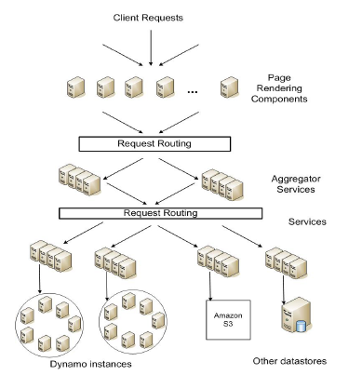
Service-oriented Architecture (SoA)

Slide 11
Design Decisions
Incremental Scalability
  Must be able to add nodes on-demand with minimal impact
  In Dynamo: a chord-like scheme is used
  In Porcupine: nodes are discovered and new groups are formed.
Load Balancing & Exploiting Heterogeneity
  In Dynamo a chord-like scheme is used
  In Porcupine nodes track CPU/disk stats

Slide 12
Design Decisions
Replication
  Must do conflict-resolution
  Porcupine is a little vague on conflict resolution
  Two questions:
    When ?
      Solve on write to reduce read complexity
      Solve on read and reduce write complexity
        Dynamo is an “always writeable” data store
        Fine for shopping carts and such services
    Who ?
      Data store
      User application

Slide 13
Design Decisions
Symmetry
  All nodes are peers in responsibility
Decentralization
  Avoid single points of failure
Both Dynamo & Porcupine agree on this

Slide 14
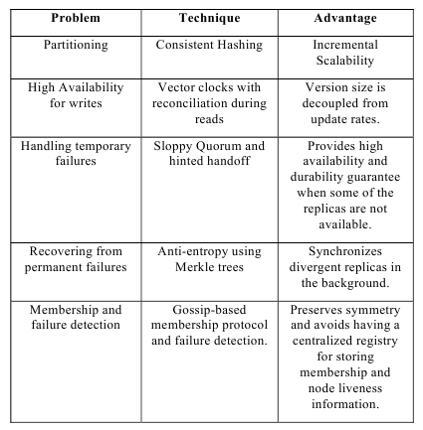
Dynamo Design Decisions

Slide 15
Dynamo's System Interface
Only two operations
put (key, context, object)
  key: primary key associated with data object
  context: vector clocks and history (needed for merging)
  object: data to store
get (key)

Slide 16
Data Partitioning & Replication
Use consistent hashing
Similar to Chord
  Each node gets an ID from the space of keys
  Nodes are arranged in a ring
  Data stored on the first node clockwise of the current placement of the data key
Replication
  Preference lists of N nodes following the associated node

Slide 17
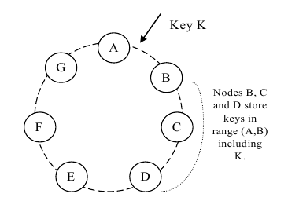
The Chord Ring

Slide 18
Virtual Nodes on the Chord Ring
A problem with the Chord scheme
  Nodes placed randomly on ring
  Leads to uneven data & load distribution
In Dynamo
  Use “virtual nodes”
  Each physical node has multiple virtual nodes
    More powerful machines have more virtual nodes
  Distribute virtual nodes across the ring

Slide 19
Data Versioning
Updates generate a new timestamp
Eventual consistency
  Multiple versions of the same object might co-exist
Syntactic Reconciliation
  System might be able to resolve conflicts automatically
Semantic Reconciliation
  Conflict resolution pushed to application

Slide 20
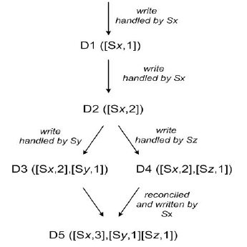
Data Versioning

Slide 21
Execution of get() & put()
Coordinator node is among the top N in the preference list
Coordinator runs a R W quorum system
  Identical to Weighted Voting System by Gifford ('79)
R = read quorum
W = write quorum
R + W > N

Slide 22
Handling Failures
Temporary failures: Hinted Handoff
  Offload your dataset to a node that follows the last of your preference list on the ring
  Hint that this is temporary
  Responsibility sent back when node recovers

Slide 23
Handling Failures
Permanent failures: Replica Synchronization
  Synchronize with another node
  Use Merkle Trees

Slide 24
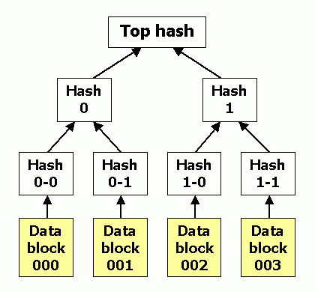
Merkle Tree

Slide 25
Membership & Failure Detection
Ring Membership
  Use background gossip to build 1-hop DHT
  Use external entity to bootstrap the system to avoid partitioned rings
Failure Detection
  Use standard gossip, heartbeats, and timeouts to implement failure detection

Slide 26
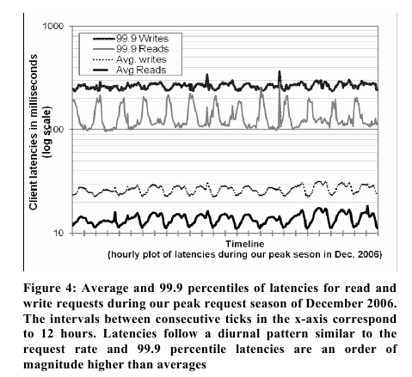
Evaluation

Slide 27
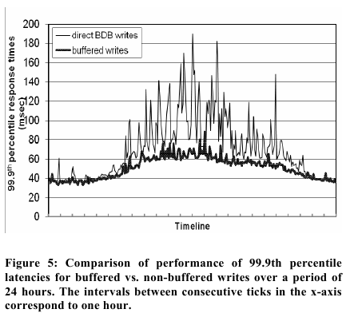
Evaluation

Slide 28
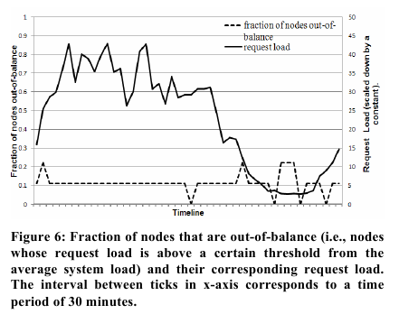
Evaluation

Slide 29
Thank You

